Slide 1
Reddit stress analysis
Problem: to find how social Karma of a Reddit user relates to his psychological factors.
Concept used: Linear regression
Investigating significant relationship between the factors and how they affect social karma of a reddit user by performing linear regression analysis.

Slide 2
Dataset and variables
Variables | Description
Subreddit | Type of stress a person goes through
Post_id | Unique ID given to each post
text | Description of the post
confidence | Accuracy level of stress, ranging from 0-1.
Social_karma | User’s net score of the post, combining the upvotes and downvotes
sentiment | Score indicating positivity or negativity of the text
Social_upvote | Corresponds to the likes of the post
Lex_dal_avg | Average of DAL score
Lex_dal_min | Minimum of DAL score
Lex_dal_max | Maximum of DAL score
Lex_liwc | Tool analyzing text data using predefined categories and provides LIWC scores for each line of text
Source of dataset: Kaggle
17 columns with different variables; 2839 rows describing various traumas, after data cleaning.
Chosen variables:
Independent variables: syntax_ari, confidence, sentiment, lex_dal_avg, social_upvote
Dependent variable: social_karma
Higher r-square values obtained with the use of these variables.
NOTE: Dictionary of Affect in Language (DAL) is a tool which rates words based on their impact on people’s emotions. It measures how pleasant, exciting and vivid the words are.

Slide 3
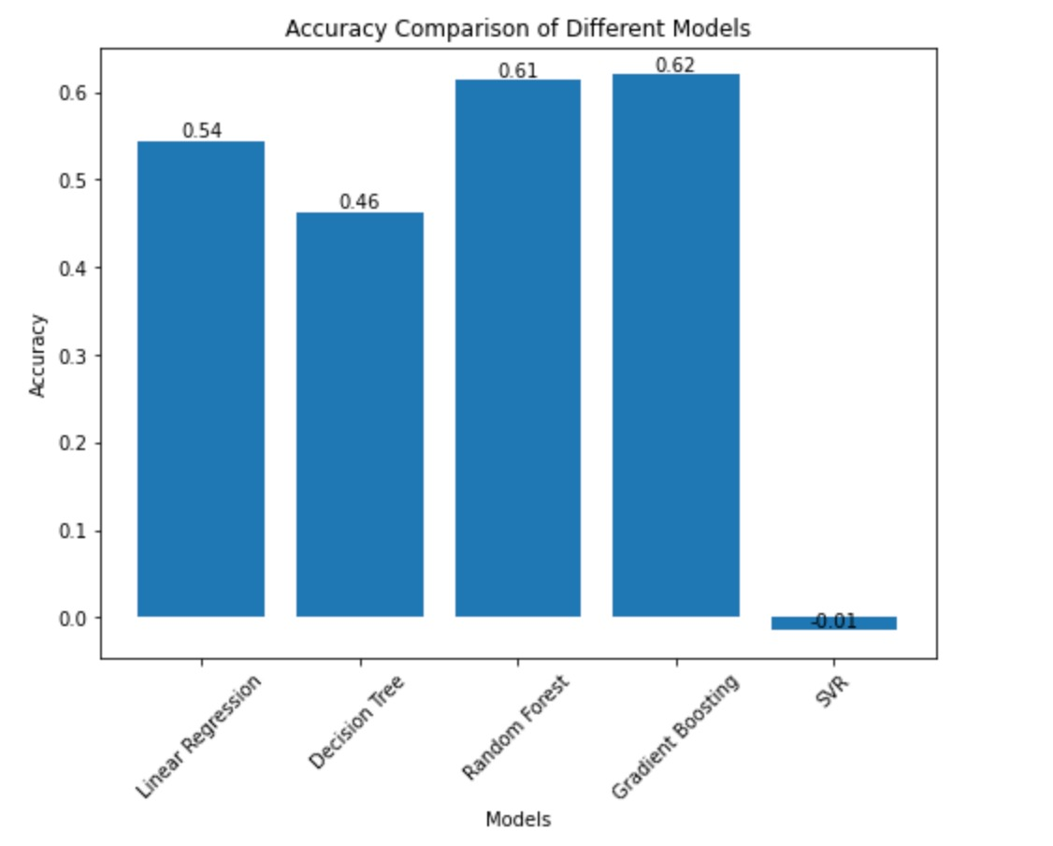
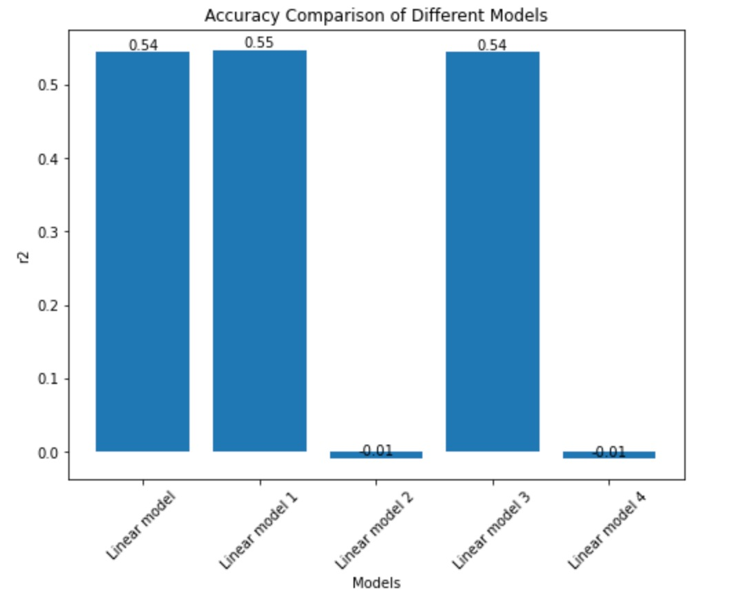
Analysis
Statistical techniques used: Linear regression Linear regression is being supported by Gradient boosting. Gradient boosting accuracy level showed at 0.62 | 4 models on linear regression were tested. Model 1 gave the highest r-square value. | Considering linear regression as effective, we then find out which variables are positively or negatively impacted. Combinations of these variables are tested to arrive at a good model.
Positive |  | Negative
syntax_ari | social_upvote | subreddit
confidence | lex_dal_avg | lex-dal_min
sentiment | lex_dal_max | syntax_fk_grade
 | lex_dal_max

